Slide 1

Android prompt user input dialog
Pemrograman Mobile
Dosen: Dwi Sunaryono

Slide 2
Android Input Dialog
A dialog is a small window that prompts the user to make a decision or enter additional information. A dialog does not fill the screen and is normally used for modal events that require users to take an action before they can proceed. The Dialog class is the base class for dialogs.
Creating a input dialog in android involves below steps
Create layout for input dialog
Inflating layout and initialize AlertDialog

Slide 3
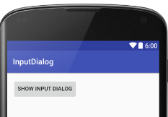
Creating input dialog layout
Buat Proyek baru dan tambahkan tombol untuk menampilkan input dialog, contoh
<LinearLayout xmlns:android="http://schemas.android.com/apk/res/android"
xmlns:tools="http://schemas.android.com/tools"
android:layout_width="match_parent"
android:layout_height="match_parent"
android:orientation="vertical"
android:padding="@dimen/activity_vertical_margin" >
<Button
android:id="@+id/button"
android:layout_width="wrap_content"
android:layout_height="wrap_content"
android:text="Show Input Dialog" />
<TextView
android:id="@+id/result"
android:layout_width="wrap_content"
android:layout_height="wrap_content"
android:textAppearance="?android:attr/textAppearanceLarge" />
</LinearLayout>

Slide 4
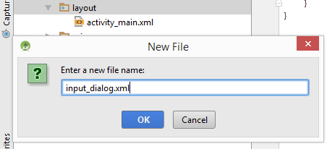
Input dialog layout (input_dialog.xml)
Input dialog layout is composed of a TextView to hint user what to enter, and a EditText to enter values.

Slide 5
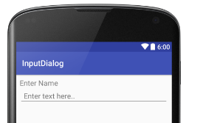
Input dialog layout (input_dialog.xml)
<?xml version="1.0" encoding="utf-8"?>
<LinearLayout
xmlns:android="http://schemas.android.com/apk/res/android"
android:layout_width="match_parent"
android:layout_height="wrap_content"
android:orientation="vertical"
android:padding="10dp">
<TextView
android:layout_width="wrap_content"
android:layout_height="wrap_content"
android:textAppearance="?android:attr/textAppearanceMedium"
android:text="Enter Name"
android:id="@+id/textView" />
<EditText
android:id="@+id/edittext"
android:layout_width="fill_parent"
android:layout_height="wrap_content"
android:hint="Enter text here.."
android:padding="10dp" />
</LinearLayout>

Slide 6
Membuat Dialog
Mengambil Layout dengan LayoutInflater, kemudian mengambil View dari inflate yang telah diambil dari setting xml dialog, setelah itu buat dialog dengan AlertDialogBuilder dan setting dialog tsb
private void tampil_input(){
LayoutInflater li = LayoutInflater.from(this);
View inputnya = li.inflate(R.layout.input_dialog,null);
AlertDialog.Builder dialognya = new
AlertDialog.Builder(this);
dialognya.setView(inputnya);
txtinput = (EditText) inputnya.findViewById(R.id.edittext);
dialognya
.setCancelable(false)
.setPositiveButton("Ok",oknya)
.setNegativeButton("Batal",oknya);
dialognya.show();
}

Slide 7
Menangani Aksi Dialog
.setPositiveButton("Ok",oknya)
.setNegativeButton("Batal",oknya);
Ditangani dengan operasi dari DialogInterface.OnClick
DialogInterface.OnClickListener oknya = new DialogInterface.OnClickListener() {
@Override
public void onClick(DialogInterface dialog, int which) {
//positif -1 negatif -2
switch (which) {
case -1: hasilnya.setText(txtinput.getText().toString());
break;
case -2:
break;
}
}
};
Kelemahan dari operasi penangan yang terpisah adalah harus membuat
variable global antara layout dengan dialognya

Slide 8
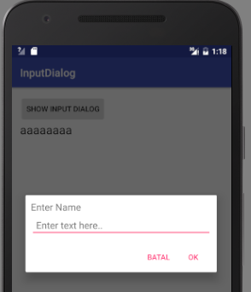
public class MainActivity extends AppCompatActivity {
private TextView hasilnya;
private EditText txtinput;
@Override
protected void onCreate(Bundle savedInstanceState) {
super.onCreate(savedInstanceState);
setContentView(R.layout.activity_main);
hasilnya = (TextView) findViewById(R.id.result);
Button btn = (Button) findViewById(R.id.button);
btn.setOnClickListener(op);
}
View.OnClickListener op = new View.OnClickListener() {
@Override
public void onClick(View v) {
switch (v.getId()) {
case R.id.button:
tampil_input();
break;
}
}
};
Variabel Global

Slide 9
private void tampil_input(){
LayoutInflater li = LayoutInflater.from(this);
View inputnya = li.inflate(R.layout.input_dialog,null);
AlertDialog.Builder dialognya = new AlertDialog.Builder(this);
dialognya.setView(inputnya);
txtinput = (EditText) inputnya.findViewById(R.id.edittext);
dialognya
.setCancelable(false)
.setPositiveButton("Ok",oknya)
.setNegativeButton("Batal",oknya);
dialognya.show();
}
DialogInterface.OnClickListener oknya = new DialogInterface.OnClickListener() {
@Override
public void onClick(DialogInterface dialog, int which) {
//positif -1 negatif -2
switch (which) {
case -1: hasilnya.setText(txtinput.getText().toString());
break;
case -2:
break;
}
}
};
}

Slide 10
Menghindari Variabel Global
Input Dialog sering dipakai sehingga lebih di rekomendasikan memakai variable local, cara ini dengan membuat aksi tekan tombol/cancel dibuat pada yang memanggilnya, bukan membuat method/fungsi yang terpisah
private void tampil_input(){
LayoutInflater li = LayoutInflater.from(this);
View inputnya = li.inflate(R.layout.input_dialog,null);
AlertDialog.Builder dialognya = new AlertDialog.Builder(this);
dialognya.setView(inputnya);
final EditText txtinput = (EditText) inputnya.findViewById(R.id.edittext);
dialognya
.setCancelable(false)
.setPositiveButton("Ok", new DialogInterface.OnClickListener() {
@Override
public void onClick(DialogInterface dialog, int which) {
hasilnya.setText(txtinput.getText().toString());
dialog.dismiss();
}
})
.setNegativeButton("Batal", new DialogInterface.OnClickListener() {
@Override
public void onClick(DialogInterface dialog, int which) {
dialog.cancel();
}
});
dialognya.show();
}

Slide 11
ListView
Pemrograman Mobile
Dosen: Dwi Sunaryono

Slide 12
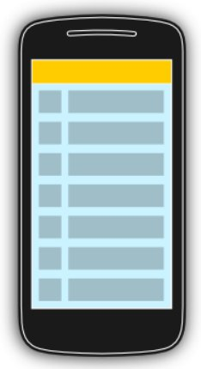
Using lists in Android
The display of elements in a list is a very common pattern in mobile applications. The user sees a list of items and can scroll through them. Such an activity is depicted in the following picture.

Slide 13
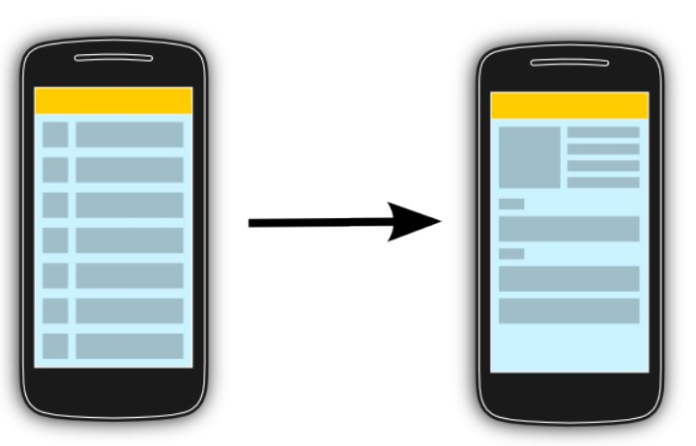
Using lists in Android (2)
Typically the user interacts with the list via the toolbar, for example, via a button which refreshes the list. Individual list items can be selected. This selection can update the toolbar or can trigger a detailed screen for the selection. The following graphic sketches that. On the selection of a list item another activity is started.

Slide 14
Using an ArrayAdapter with ListView
In Android development, any time we want to show a vertical list of scrollable items we will use a ListView which has data populated using an Adapter. The simplest adapter to use is called an ArrayAdapter because the adapter converts an ArrayList of objects into View items loaded into the ListView container.

Slide 15
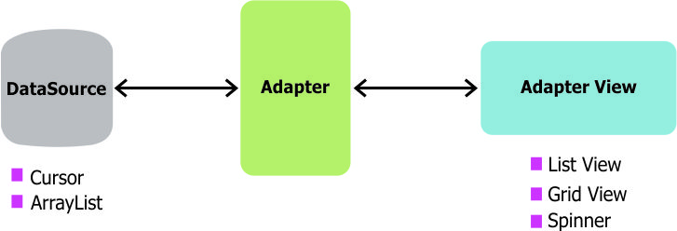
Using an ArrayAdapter with ListView (2)
The ArrayAdapter fits in between an ArrayList (data source) and the ListView (visual representation) and configures two aspects:
Which array to use as the data source for the list
How to convert any given item in the array into a corresponding View object
Note as shown above that there are other data sources besides an ArrayAdapter such as the CursorAdapter which instead binds directly to a result set from a Local SQLite Database.

Slide 16
Row View Recycling
When using an adapter and a ListView, we need to make sure to understand how view recycling works.
When your ListView is connected to an adapter, the adapter will instantiate rows until the ListView has been fully populated with enough items to fill the full height of the list. At that point, no additional row items are created in memory.
Instead, as the user scroll through the list, items that leave the screen are kept in memory for later use and then every new row that enters the screen reuses an older row kept around in memory. In this way, even for a list of 1000 items, only ~7 item view rows are ever instantiated or held in memory.

Slide 17
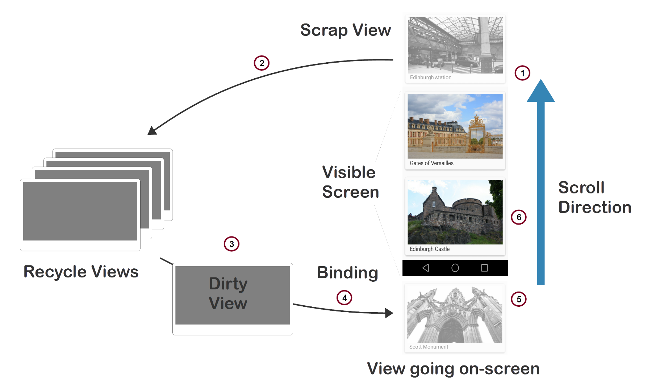
Here is a visual overview of recycling:

Slide 18
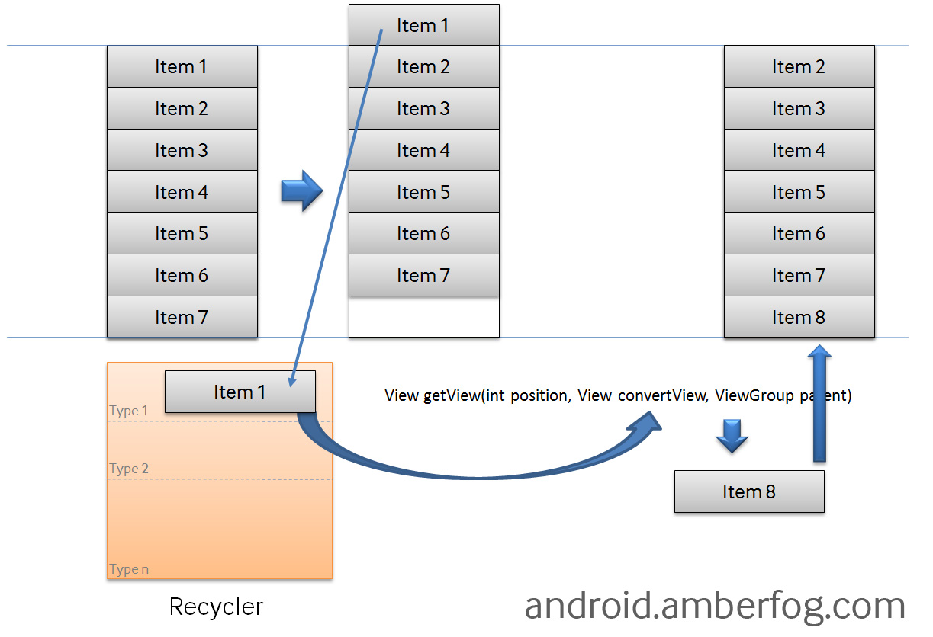
Here is another related diagram on view recycling
:

Slide 19
Using a Basic ArrayAdapter
To use a basic ArrayAdapter, you just need to initialize the adapter and attach the adapter to the ListView. First, we initialize the adapter:
ArrayAdapter<String> itemsAdapter = new ArrayAdapter<String>(this, android.R.layout.simple_list_item_1, items);
The ArrayAdapter requires a declaration of the type of the item to be converted to a View (a String in this case) and then accepts three arguments: context (activity instance), XML item layout, and the array of data. Note that we've chosen simple_list_item_1.xml which is a simple TextView as the layout for each of the items.

Slide 20
Using a Basic ArrayAdapter (2)
Now, we just need to connect this adapter to a ListView to be populated:
ListView listView = (ListView) findViewById(R.id.lvItems);
listView.setAdapter(itemsAdapter);
By default, this will now convert each item in the data array into a view by calling toString on the item and then assigning the result as the value of a TextView (simple_list_item_1.xml) that is displayed as the row for that data item. If the app requires a more complex translation between item and View then we need to create a custom ArrayAdapter instead.

Slide 21
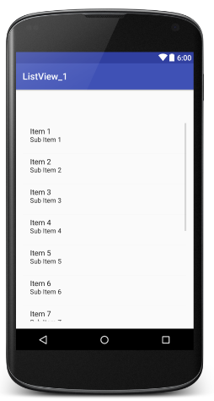
Contoh ListView Sederhana
Buat Project sederhana dan tambahkan ListView Seperti berikut
<?xml version="1.0" encoding="utf-8"?>
<RelativeLayout xmlns:android="http://schemas.android.com/apk/res/android"
xmlns:tools="http://schemas.android.com/tools"
android:layout_width="match_parent"
android:layout_height="match_parent"
android:paddingBottom="@dimen/activity_vertical_margin"
android:paddingLeft="@dimen/activity_horizontal_margin"
android:paddingRight="@dimen/activity_horizontal_margin"
android:paddingTop="@dimen/activity_vertical_margin"
tools:context="com.example.gondar.listview_1.MainActivity">
<ListView
android:layout_width="wrap_content"
android:layout_height="wrap_content"
android:id="@+id/listView"
android:layout_alignParentTop="true"
android:layout_alignParentLeft="true"
android:layout_alignParentStart="true"
android:layout_marginTop="56dp" />
</RelativeLayout>

Slide 22
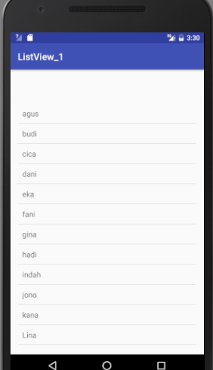
MainActivity.java
package com.example.gondar.listview_1;
import android.support.v7.app.AppCompatActivity;
public class MainActivity extends AppCompatActivity {
private ListView lv;
private ArrayAdapter<String> kontak;
@Override
protected void onCreate(Bundle savedInstanceState) {
super.onCreate(savedInstanceState);
setContentView(R.layout.activity_main);
lv = (ListView) findViewById(R.id.listView);
String[] nama = new String[] {"agus","budi","cica","dani",
"eka","fani","gina","hadi","indah",
"jono","kana","Lina","Maya","Nanik","Opi"};
ArrayList<String> listNama = new ArrayList<>();
listNama.addAll(Arrays.asList(nama));
kontak = new ArrayAdapter<String>(this,R.layout.simplerow,listNama);
lv.setAdapter(kontak);
}
}

Slide 23
Using a Custom ArrayAdapter
When we want to display a series of items into a list using a custom representation of the items, we need to use our own custom XML layout for each item. To do this, we need to create our own custom ArrayAdapter class. See this repo for the source code. First, we often need to define a model to represent the data within each list item.

Slide 24
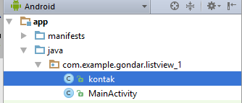
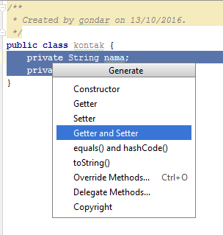
Defining the Model
Given a Java object that has certain fields defined such as a “kontak” class:
public class kontak {
private String nama;
private String noHp;

Slide 25
Kelas kontak
public class kontak {
private String nama;
private String noHp;
public kontak(String nama, String noHp) {
this.nama = nama;
this.noHp = noHp;
}
public String getNoHp() { return noHp;}
public void setNoHp(String noHp) {this.noHp = noHp;}
public String getNama() {return nama;}
public void setNama(String nama) {this.nama = nama;}
}

Slide 26
subclassing ArrayAdapter
We can create a custom ListView of “kontak” objects by subclassing ArrayAdapter to describe how to translate the object into a view within that class and then using it like any other adapter.

Slide 27
Creating the View Template
Next, we need to create an XML layout that represents the view template for each item in res/layout/item_user.xml:
<LinearLayout xmlns:android="http://schemas.android.com/apk/res/android"
android:layout_width="match_parent"
android:layout_height="match_parent" >
<TextView
android:id="@+id/tNama"
android:layout_width="wrap_content"
android:layout_height="wrap_content"
android:text="Nama" />
<TextView
android:id="@+id/tnoHp"
android:layout_width="wrap_content"
android:layout_height="wrap_content"
android:text="No Hp" />
</LinearLayout>

Slide 28
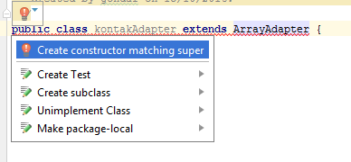
Defining the Adapter
Next, we need to define the adapter to describe the process of converting the Java object to a View (in the getView method). The naive approach to this (without any view caching) looks like the following:
public class kontakAdapter extends ArrayAdapter<kontak> {
public kontakAdapter(Context context,
int resource, List<kontak> objects) {
super(context, resource, objects);
}
}

Slide 29
public class kontakAdapter extends ArrayAdapter<kontak> {
public kontakAdapter(Context context, int resource,
List<kontak> objects) {
super(context, resource, objects);
}
public View getView(int position, View ConvertView,
ViewGroup parent){
kontak dtkontak= getItem(position);
if(ConvertView==null){
ConvertView = LayoutInflater.from(getContext()).
inflate(R.layout.item_user,parent,false);
}
TextView tNama= (TextView) ConvertView.findViewById(R.id.tNama);
TextView tnoHp= (TextView) ConvertView.findViewById(R.id.tnoHp);
tNama.setText(dtkontak.getNama());
tnoHp.setText(dtkontak.getNoHp());
return ConvertView;
}
}

Slide 30
Adapter & getView()
That adapter has a constructor and a getView() method to describe the translation between the data item and the View to display. getView() is the method that returns the actual view used as a row within the ListView at a particular position. Another method used is getItem() which is already present in the ArrayAdapter Class and its task is to simply get the data item associated with the specified position in the data set which is associated with that ArrayAdapter.

Slide 31
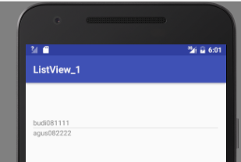
Attaching the Adapter to a ListView
Now, we can use that adapter in the Activity to display an array of items into the ListView:
public class MainActivity extends AppCompatActivity {
private ListView lv;
@Override
protected void onCreate(Bundle savedInstanceState) {
super.onCreate(savedInstanceState);
setContentView(R.layout.activity_main);
lv = (ListView) findViewById(R.id.listView);
ArrayList<kontak> listKontak = new ArrayList<kontak>();
kontakAdapter kAdapter = new kontakAdapter(this,0,listKontak);
lv.setAdapter(kAdapter);
kontak newKontak1 = new kontak("budi","081111");
kontak newKontak2 = new kontak("agus","082222");
kAdapter.add(newKontak1);
kAdapter.add(newKontak2);
}
}

Slide 32
Improving Performance with the ViewHolder Pattern
To improve performance, we should modify the custom adapter by applying the ViewHolder pattern which speeds up the population of the ListView considerably by caching view lookups for smoother, faster item loading

Slide 33
public class kontakAdapter extends ArrayAdapter<kontak> {
// View lookup cache
private static class ViewHolder {
TextView nama; TextView nohp;}
public kontakAdapter(Context context, int resource, List<kontak> objects) {
super(context, resource, objects);
}
public View getView(int position, View ConvertView, ViewGroup parent){
kontak dtkontak= getItem(position);
// Check if an existing view is being reused, otherwise inflate the view
ViewHolder viewKontak; // view lookup cache stored in tag
if(ConvertView==null){
// If there's no view to re-use, inflate a brand new view for row
viewKontak = new ViewHolder();
ConvertView = LayoutInflater.from(getContext()).
inflate(R.layout.item_kontak,parent,false);
viewKontak.nama = (TextView) ConvertView.findViewById(R.id.tNama);
viewKontak.nohp = (TextView) ConvertView.findViewById(R.id.tnoHp);
// Cache the viewHolder object inside the fresh view
ConvertView.setTag(viewKontak);
Button btn = (Button) ConvertView.findViewById(R.id.btn);
btn.setTag(position);btn.setOnClickListener(op);
}
else
{ viewKontak = (ViewHolder) ConvertView.getTag();}
viewKontak.nama.setText(dtkontak.getNama());
viewKontak.nohp.setText(dtkontak.getNoHp());
return ConvertView;
}

Slide 34
In this example we also have a private static class called ViewHolder. Making calls to findViewById() can be slow in practice, and if your adapter has to call it for each View in your row for every single row then you can often run into performance issues. What the ViewHolder class does is cache the call to findViewById(). Once your ListView has reached the max amount of rows it can display on a screen, Android is smart enough to begin recycling those row Views. We check if a View is recycled with if (convertView == null). If it is not null then we have a recycled View and can just change its values, otherwise we need to create a new row View. The magic behind this is the setTag() method which lets us attach an arbitrary object onto a View object, which is how we save the already inflated View for future reuse.

Slide 35
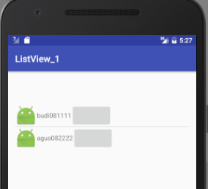
Menambah ImageView
Image View dapat ditambahkan ke layout xml pada contoh adalah file item_kontak.xml
Dan satu tambahan di kontakAdapater.java
pada kelas getView()
<android.support.v7.widget.AppCompatImageView
android:layout_width="wrap_content"
android:layout_height="wrap_content"
android:src="@mipmap/ic_launcher"
android:id="@+id/img"
/>
ImageView img = (ImageView) ConvertView.findViewById(R.id.img);

Slide 36
ListView dan InputDialog
Pemrograman Mobile
Dosen: Dwi Sunaryono

Slide 37
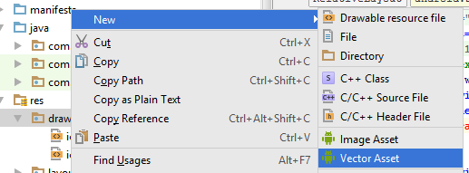
Menambahkan ListView dengan Input Dialog
Layout Utama dapat ditambahkan operasi database berupa: Add, Del, Edit, Find
Siapkan dulu icon-icon yang sesuai dengan cara New-Vector Asset

Slide 38
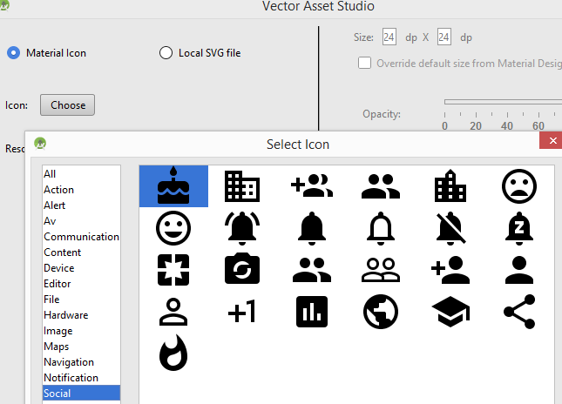
Mengambil Asset Vektor
Choose Icon yang sesuai kemudian beri nama yang mudah lalu next dan tekan finish

Slide 39
Menambah Tombol
Pada MainActivity.xml, tambahkan tombol imagebutton serta src, isikan dengan asset vector yang telah di masukkan
Ulangi untuk semua tombol yang akan dipakai
<android.support.v7.widget.AppCompatImageButton
android:layout_width="wrap_content"
android:layout_height="wrap_content"
android:src="@drawable/ic_person_add"
/>

Slide 40
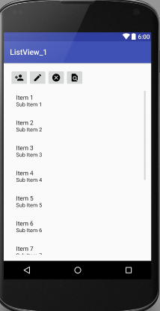
Tombol Tambahan
<android.support.v7.widget.AppCompatImageButton
android:layout_width="wrap_content"
android:layout_height="wrap_content"
android:id="@+id/add"
android:src="@drawable/ic_person_add"
/>
<android.support.v7.widget.AppCompatImageButton
android:layout_width="wrap_content"
android:layout_height="wrap_content"
android:id="@+id/edit"
android:src="@drawable/ic_create"
android:layout_alignParentTop="true"
android:layout_toRightOf="@+id/add"
android:layout_toEndOf="@+id/add" />
<android.support.v7.widget.AppCompatImageButton
android:layout_width="wrap_content"
android:layout_height="wrap_content"
android:id="@+id/del"
android:src="@drawable/ic_cancel"
android:layout_alignParentTop="true"
android:layout_toRightOf="@+id/edit"
android:layout_toEndOf="@+id/edit" />
<android.support.v7.widget.AppCompatImageButton
android:layout_width="wrap_content"
android:layout_height="wrap_content"
android:id="@+id/cari"
android:src="@drawable/ic_find"
android:layout_alignParentTop="true"
android:layout_toRightOf="@+id/del"
android:layout_toEndOf="@+id/del" />

Slide 41
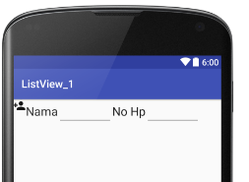
Menambah List View dengan Input Dialog
<LinearLayout xmlns:android="http://schemas.android.com/apk/res/android"
android:layout_width="match_parent"
android:layout_height="match_parent" >
<android.support.v7.widget.AppCompatImageView
android:layout_width="wrap_content"
android:layout_height="wrap_content"
android:src="@drawable/ic_person_add"
android:id="@+id/img"
/>
<TextView
android:layout_width="wrap_content"
android:layout_height="wrap_content“
android:textAppearance="?android:attr/textAppearanceLarge"
android:text="Nama" />
<EditText
android:layout_width="200px"
android:layout_height="wrap_content"
android:id="@+id/nm"
/>
<TextView
android:layout_width="wrap_content"
android:layout_height="wrap_content"
android:text="No Hp" />
<EditText
android:layout_width="200px"
android:layout_height="wrap_content"
android:id="@+id/hp"
/>
</LinearLayout>
Tambahkan desain xml (add_kontak.xml) untuk input dialog yang memuat gambar, nama dan hp seperti dibawah ini

Slide 42
MainActivity.Java
Pada ListView Sebelumnya, Ubah Adapater menjadi Variabel Global
public class MainActivity extends AppCompatActivity {
private ListView lv;
private ImageView add;
private kontakAdapter kAdapter;
buat fungsi untuk menambah kan ke listview
private void add_item(String nm, String hp)
{
kontak newKontak = new kontak(nm,hp);
kAdapter.add(newKontak);
}

Slide 43
Buat Input Dialog
Saat Tombol Tambah di tekan (icon +), fungsi yang dijalankan adalah tambah_data
add = (ImageView) findViewById(R.id.tambah);
add.setOnClickListener(operasi);
View.OnClickListener operasi= new View.OnClickListener() {
@Override
public void onClick(View v) {
switch (v.getId()){
case R.id.tambah:tambah_data();break;
}
}
};

Slide 44
private void tambah_data(){
AlertDialog.Builder buat = new AlertDialog.Builder(this);
buat.setTitle("Add Kontak");
View vAdd = LayoutInflater.from(this).inflate
(R.layout.add_kontak,null);
final EditText nm = (EditText) vAdd.findViewById(R.id.nm);
final EditText hp = (EditText) vAdd.findViewById(R.id.hp);
buat.setView(vAdd);
buat.setPositiveButton(android.R.string.ok, new
DialogInterface.OnClickListener() {
@Override
public void onClick(DialogInterface dialog, int which) {
add_item( nm.getText().toString(),hp.getText().toString());
Toast.makeText(getBaseContext(),"Data Tersimpan",
Toast.LENGTH_LONG).show();
dialog.dismiss();
}
});
buat.setNegativeButton(android.R.string.cancel, new
DialogInterface.OnClickListener() {
@Override
public void onClick(DialogInterface dialog, int which) {
dialog.cancel();
}
});
buat.show();
}

Slide 45
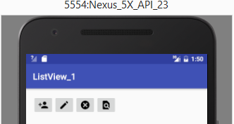
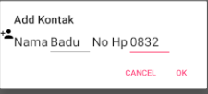
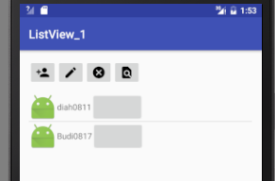
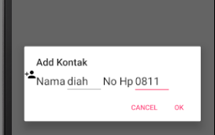
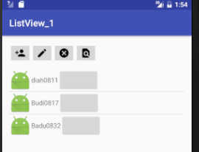
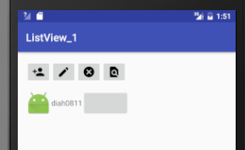
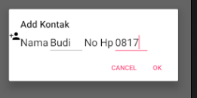

Slide 46
public class MainActivity extends AppCompatActivity {
private ListView lv;
private ImageView add;
private kontakAdapter kAdapter;
@Override
protected void onCreate(Bundle savedInstanceState) {
super.onCreate(savedInstanceState);
setContentView(R.layout.activity_main);
lv = (ListView) findViewById(R.id.listView);
add = (ImageView) findViewById(R.id.tambah);
add.setOnClickListener(operasi);
ArrayList<kontak> listKontak = new ArrayList<kontak>();
kAdapter = new kontakAdapter(this,0,listKontak);
lv.setAdapter(kAdapter);
}
View.OnClickListener operasi= new View.OnClickListener() {
@Override
public void onClick(View v) {
switch (v.getId()){
case R.id.tambah:tambah_data();break;
}
}
};
Program Selengkapnya

Slide 47
private void add_item(String nm, String hp)
{
kontak newKontak = new kontak(nm,hp);
kAdapter.add(newKontak);
}
private void tambah_data(){
AlertDialog.Builder buat = new AlertDialog.Builder(this);
buat.setTitle("Add Kontak");
View vAdd = LayoutInflater.from(this).inflate(R.layout.add_kontak,null);
final EditText nm = (EditText) vAdd.findViewById(R.id.nm);
final EditText hp = (EditText) vAdd.findViewById(R.id.hp);
buat.setView(vAdd);
// Set up the buttons
buat.setPositiveButton(android.R.string.ok, new DialogInterface.OnClickListener() {
@Override
public void onClick(DialogInterface dialog, int which) {
add_item( nm.getText().toString(),hp.getText().toString());
Toast.makeText(getBaseContext(),"Data Tersimpan",Toast.LENGTH_LONG).show();
dialog.dismiss();
}
});
buat.setNegativeButton(android.R.string.cancel, new DialogInterface.OnClickListener() {
@Override
public void onClick(DialogInterface dialog, int which) {
dialog.cancel();
}
});
buat.show();
}
}
Program Selengkapnya

Slide 48
ListView dan Database
Pemrograman Mobile
Dosen: Dwi Sunaryono

Slide 49
Database: SQLiteDatabase & SQLHelper
Tambahkan variable global bertipe SQLiteDatabase & SQLHelper
public class MainActivity extends AppCompatActivity {
private ListView lv;
private ImageView add;
private kontakAdapter kAdapter;
private SQLiteDatabase dbku;
private SQLiteOpenHelper dbopen;

Slide 50
Buat Database & Tabel
dbopen = new SQLiteOpenHelper(this,"kontak.db",null,1) {
@Override
public void onCreate(SQLiteDatabase db) {
} @Override
public void onUpgrade(SQLiteDatabase db, int oldVersion, int newVersion) { }
};
dbku = dbopen.getWritableDatabase();
dbku.execSQL("create table if not exists kontak(nama TEXT, nohp TEXT);");

Slide 51
Modifikasi Fungsi add_item
private void add_item(String nm, String hp)
{
ContentValues datanya = new ContentValues();
datanya.put("nama",nm);
datanya.put("nohp",hp);
dbku.insert("kontak",null,datanya);
kontak newKontak = new kontak(nm,hp);
kAdapter.add(newKontak);
}
Pada saat awal program berjalan … ambil semua data yang ada di database

Slide 52
Buat Fungsi AmbilData
private void insertKontak(String nm, String hp)
{
kontak newKontak = new kontak(nm,hp);
kAdapter.add(newKontak);
}
private void ambildata()
{
Cursor cur = dbku.rawQuery("select * from kontak",null);
Toast.makeText(this,"Terdapat sejumlah " + cur.getCount(),
Toast.LENGTH_LONG).show();
int i=0;if(cur.getCount() > 0) cur.moveToFirst();
while(i<cur.getCount())
{
insertKontak(cur.getString(cur.getColumnIndex("nama")),
cur.getString(cur.getColumnIndex("nohp")));
cur.moveToNext();
i++;
}
}

Slide 53
Tambahkan AmbilData ke awal Program di jalankan OnCreate
protected void onCreate(Bundle savedInstanceState) {
super.onCreate(savedInstanceState);
setContentView(R.layout.activity_main);
lv = (ListView) findViewById(R.id.listView);
add = (ImageView) findViewById(R.id.tambah);
add.setOnClickListener(operasi);
ArrayList<kontak> listKontak = new ArrayList<kontak>();
kAdapter = new kontakAdapter(this,0,listKontak);
lv.setAdapter(kAdapter);
dbopen = new SQLiteOpenHelper(this,"kontak.db",null,1) {
@Override
public void onCreate(SQLiteDatabase db) {
} @Override
public void onUpgrade(SQLiteDatabase db, int oldVersion, int newVersion) { }
};
dbku = dbopen.getWritableDatabase();
dbku.execSQL("create table if not exists kontak(nama TEXT, nohp TEXT);");
ambildata();
}

Slide 54
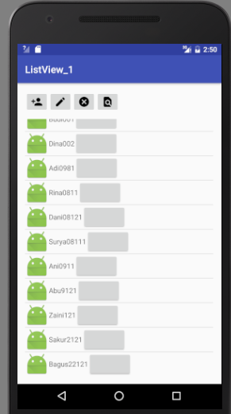
Program Dijalankan akan langsung mengambil data dari database

Slide 55
Todo Next
Bagaimana dengan Edit, Delete, Cari ?
Bagaimana dengan kontak yang langsung terhubung ke telpon ?

